Slide 1

Bringing healthy food to your desk…

Slide 2
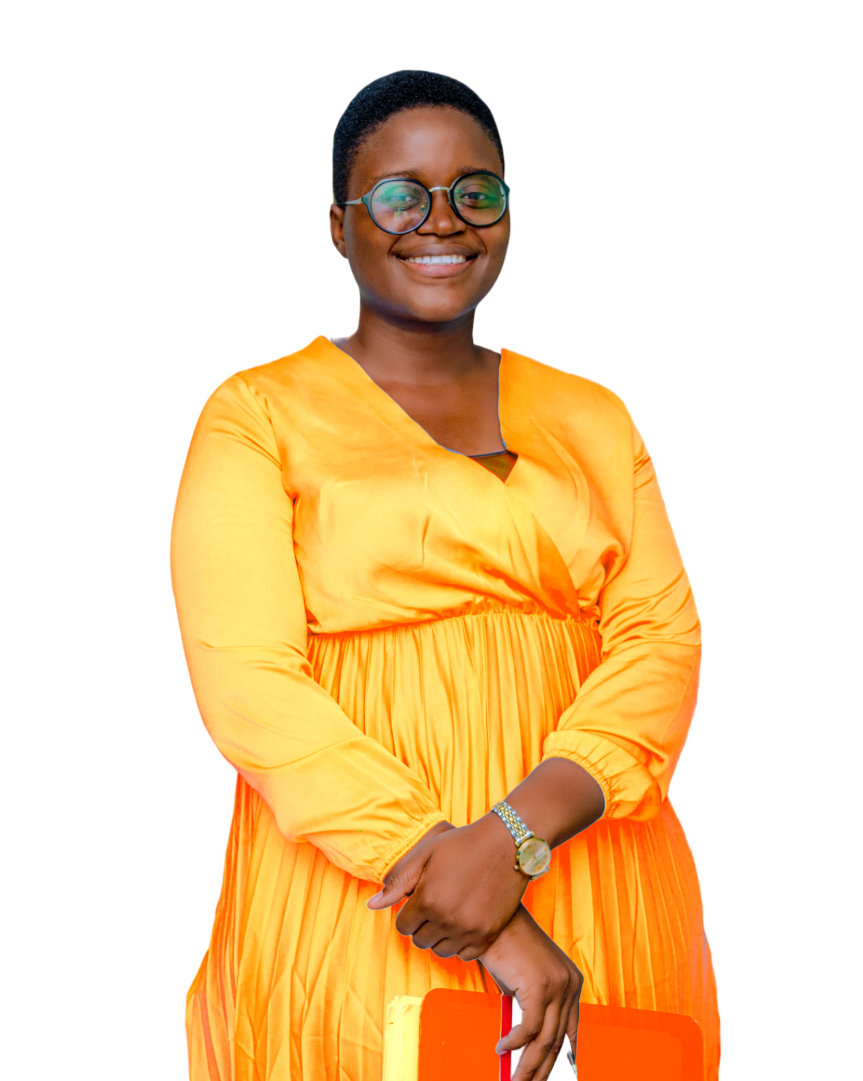
Hello Everyone, My name is Ruth, some months ago I resigned from my 9 to 5 job in order to fully meet up with the responsilities of a mum due to some readjustments in the family. Prior to my resignation, in the course of a conversation with a friend and thinking of the what next phase, she reminded me of some meals (eru) to be precise she had eaten at my home. Just then the idea to cook at home and sell came up and Shiloh’s delicacies was born.

Slide 3
II.PROBLEMS FACED
During my days in the white collar job I had noticed the following problems faced:
Difficult access to food at a given time
Food that met our desires was scarce to find
Eating healthy was not a routine.
Our foods needed to have basic nutrients that contribute in building our immune systems and most especially help us stay healthy.

Slide 4
III.SOLUTIONS
Shiloh’s delicacies is not just a food delivery initiative. Its concept came from a place of love and its desire and actions so far has been to;
Bring home food to our clients at their demand to their specific destinations
Ensure that our meals respect dietary standards as we use high quality and fresh ingredients from our pots to their mouths.
Most especially we ensure a constant communication with our clients to get their feedback and propositions on how to ensure a positive health dieting.
We give that special touch of keeping in touch with our clients and going the extra mile to satisfy their cravings// yes their cravings.

Slide 5
IV. UNIQUENESS
That’s where we make a difference. Having observing the reality of the economic realities, we came up with a price tag that meat the average Cameroonian. Since our aim is to feed and not to make people poor.
Our prices ranging from a 1000 fcfa to infinity admist the quality services we render sets SD out of the normal
Our dynamic meal menu which is meant at satisfying the clients health needs and cravings.
The most important which with which we season our meals before which is love as we imagine the smiles on our clients faces when we deliver.

Slide 6
V. MARKET
At the beginning, as I earlier said, we targeted a very small market since we were just out to make meals to be happy.
But now, we are targeting Cameroon and yes the Globe. Cause after all if you can thrive in Cameroon, you can certainly thrive everywhere.
SO yes, SD intends reaching to every corner where its number is dialed.

Slide 7
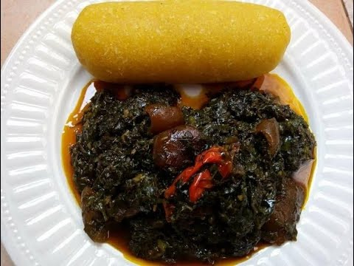
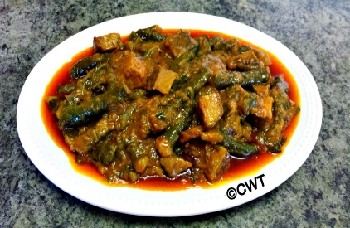
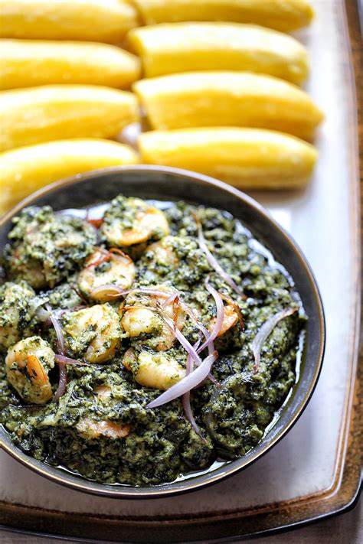
VI. MEALS
We offer a dynamic meal menu mostly centered on food grown here in Cameroon. Most especially you won’t want to taste any other thing if you taste our
Eru
Ekwang
Ndole

Slide 8
VII. TEAM
Certainly we are a young team of 3 dynamic ladies and a man daily improving on ourselves to satisfy our clients, but given our intention to expand our scope we are sure to be recruiting soon in order to satisfy the growing market.

Slide 9
VIII. PROSPECTS
So far, based on certain feedback, we are working towards a better timely delivery service as we understand that it’s not just about eating, but eating at the right time.
The goal has always been to serve a complete meal to our clients that is entrée, main course, appetizer (goal) and we are gradually working towards achieving that goal.
The demand from our clients is becoming too much for our facilities especially as they request a need for an SD home where they could better digest the meals we serve. We look towards getting investors to assist us attain that goal.

Slide 10

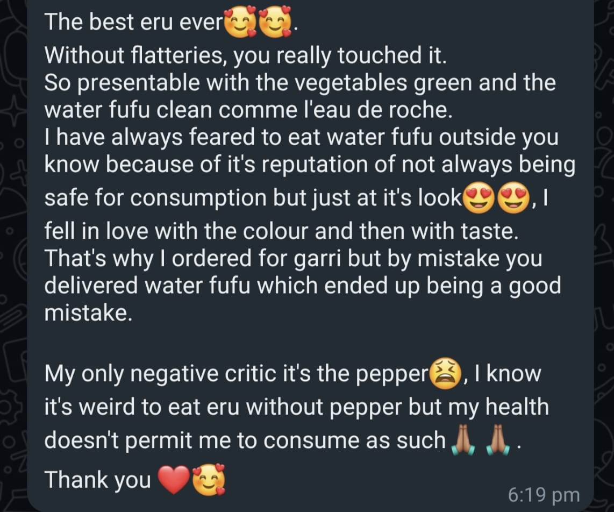
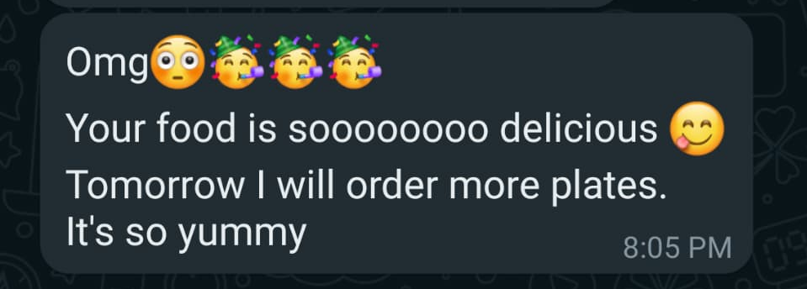
IX. CLIENT REVIEW

Slide 11
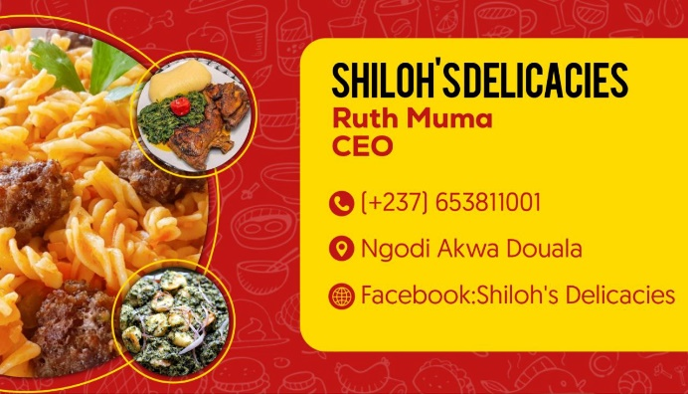

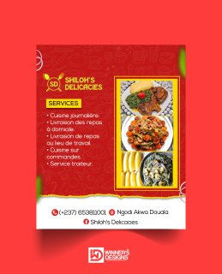
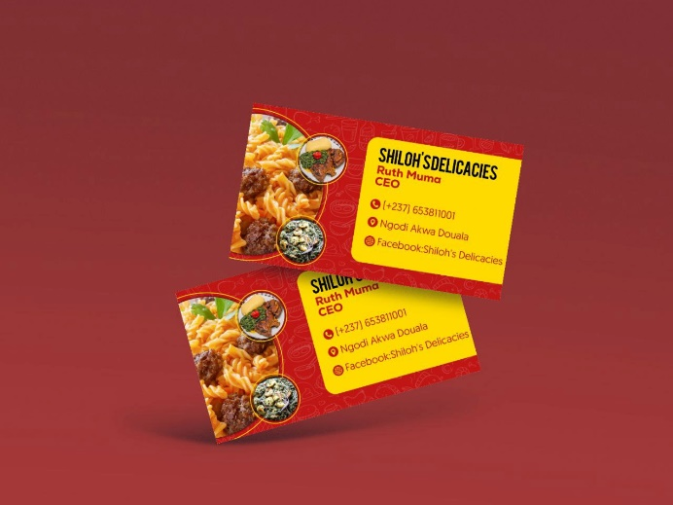

THE BRAND

Slide 12
THANK YOU !!!

